Slide 1
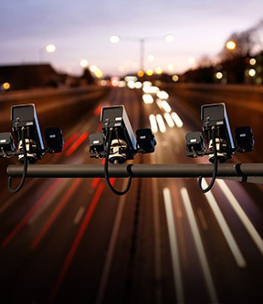
EXPRESSWAY VEHICLE TRACKING SYSTEM IMAGE PROCESSING
CDAP|Project Proposal Presentation
Project ID : 2021-238

Slide 2




OUR TEAM
R.A.H.D. Pabasara
IT17023306
devdunie.r@gmail.com
Tennakoon T.M.P.J.A.
IT18148732
(+94) 71 2374237
amandajayani1998@gmail.com
Bojitha Mindula A.M.K
IT18134018
(+94) 71 3579450
IT18134018@my.sliit.lk
Ranasinghe M.M.C
IT18097634
(+94) 71 8772549
IT18097634@my.slit.lk
Rushdy Ahamed M.H
IT18185812
(+94) 77 713 7622
IT18185812@my.sliit.lk

Slide 3
Introduction
In Sri Lanka, many people using express ways for travelling.
Accidents occur in express ways are increasing day by day.
Detecting traffic rules violation effectively has become a major concern.
We have identified some major rules violations that people do in the express ways in Sri Lanka.
Our system can recognize the vehicle data and detect the traffic rules violation efficiently using image processing approaches.

Slide 4

Research problems
There are problems in Vehicle type detection is the automatically.
There are problems in Parking violation detection where a vehicle parks in express way without a permission or a special reason
There are problems in Road Lane Violation detection where a vehicle continuously drives in the wrong lane (second lane).
There are problems in Speed violation detection where a vehicle exceeding the speed limit of the expressway.
There are problems in Signal violation detection where a vehicle overtakes another vehicle without giving signals.
There are problems in Reverse violation detection where a vehicle moving in reverse.

Slide 5

Objectives
Object detection using image processing
Detecting Parking violation and Road Lane violation using image processing
Detecting Speed Violation using image processing
Detecting Signal Violation and Reverse Violation using image processing

Slide 6
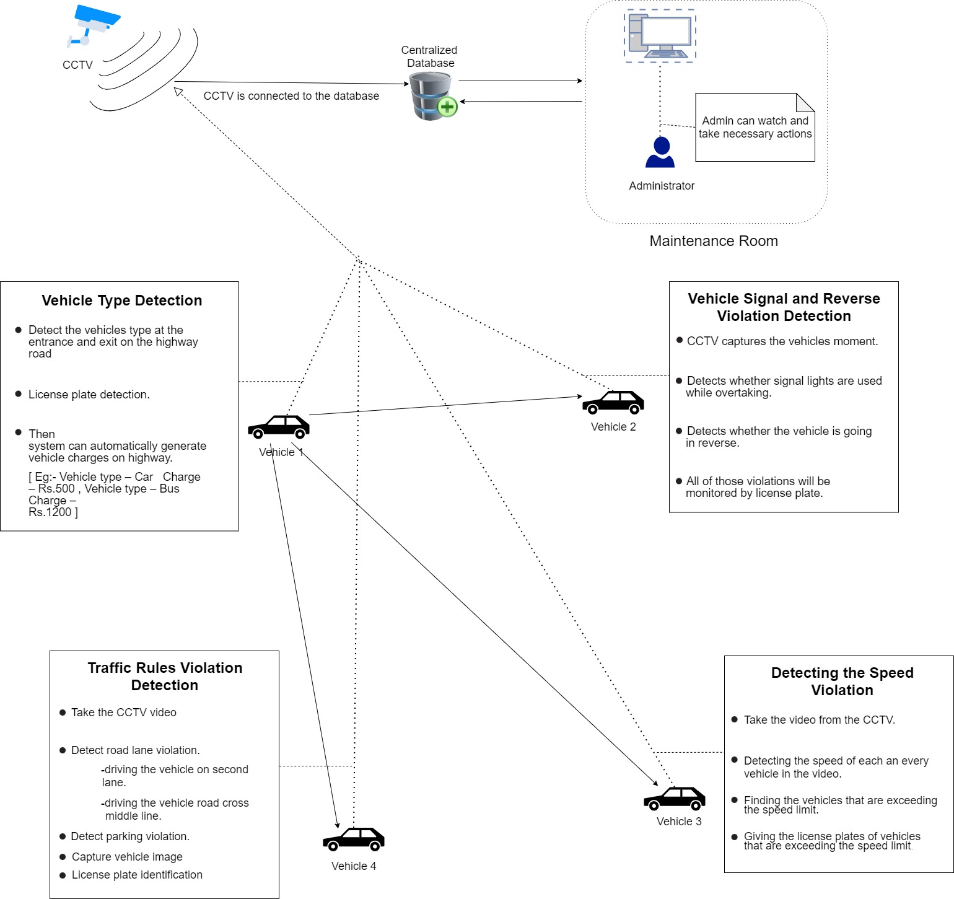
System Diagram

Slide 7

IT18134018 Bojitha Mindula A.M.K
Software Engineering
IT18134018 | Bojitha Mindula A.M.K | 2021-238

Slide 8
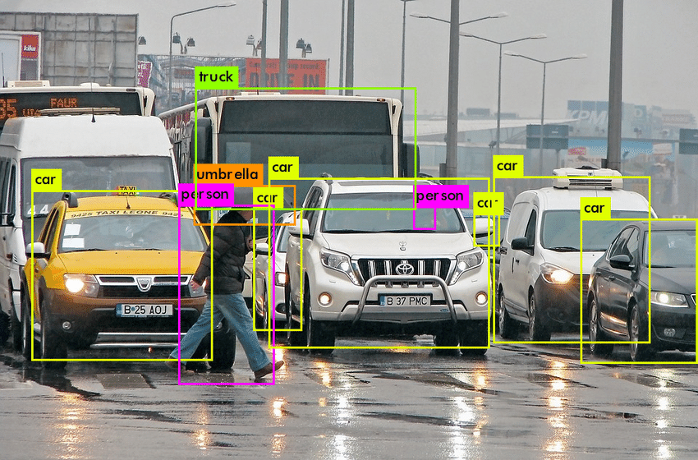
Vehicle Type and License Plate Detection
There are few systems available on expressway to detect vehicle type.
There are no proper system to identify vehicle type and license plate.
Automatic identification of vehicle type and license plate for use video surveillance.
IT18134018 | Bojitha Mindula A.M.K | 2021-238

Slide 9
Background
The ever-increasing number of violations of traffic rules has become a critical challenge in Sri Lanka.
The solution is to install vehicle type detection and license plate detection systems on the expressway.
The system can automatically detect vehicle type and license plate .
The aim of this research work is to build up an automated system.
IT18134018 | Bojitha Mindula A.M.K | 2021-238

Slide 10


Research Gap
Comparison of existing solutions
Research | Identify the Object Automatically | Identify the Vehicle Type | Detect the Number Plate Automatically | Add the Penalty Fees | Generate a Bill Automatically
1.Intelligent video surveillance: a review through deep learning techniques for crowd analysis
2.Review on Image Processing Based Vehicle Detection & Tracking System
3.Vehicle detection and classification: A review
4.Dynamic traffic rule violation monitoring system using automatic number plate recognition with SMS feedback
Proposed Solution
IT18134018 | Bojitha Mindula A.M.K | 2021-238

Slide 11

Research Problem
How to automate the vehicle type detection process in normal day and special day at the expressway system in Sri Lanka?
IT18134018 | Bojitha Mindula A.M.K | 2021-238

Slide 12
Objectives
To develop an automated surveillance system for the expressway system in Sri Lanka to automatically detect vehicle type in normal day and special day.
Critically study the current practices and issues in vehicle type detection and number plate detection.
Design and develop the functionality of vehicle detection and classification.
Design and develop the functionality of number plate detection.
Tests and evaluate the system and compare the functionality against the software requirement specification.
IT18134018 | Bojitha Mindula A.M.K| 2021-238

Slide 13
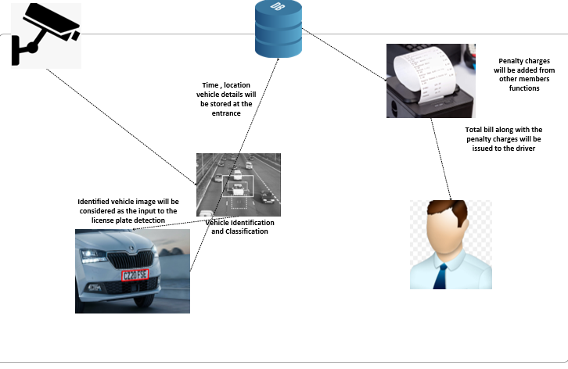
Methodology
Overview of System
IT18134018 | Bojitha Mindula A.M.K | 2021-238

Slide 14

Technologies and Algorithms
Technologies -
Python
PyCharm
Algorithms -
YOLOv3
Regions with Convolutional Neural Network (RCNN)
IT18134018 | Bojitha Mindula A.M.K | 2021-238
14

Slide 15
Requirements
Functional Requirements
Vehicle object shall be detected.
Detected object shall be classified into the correct vehicle type.
License plate shall be detected and the vehicle number when a vehicle enters the expressway.
The system shall be able to identify and store the details of the entrance point.
Non - Functional Requirements
The system shall be responsive.
The system shall be available.
Performance of the system shall be ensured.
The system shall be secured.
IT18134018 | Bojitha Mindula A.M.K | 2021-238

Slide 16

Requirements
System Requirements
OS: Windows 10,8,7
CPU: Intel or AMD processor with 64-bit support
GPU: NVidia GeForce GTX 1050 or equivalent
Disk Storage: 5 GB of free disk space
Internet: Highspeed stable internet connection
Personnel Requirements
User has little bit knowledge of use software application
Remove unnecessary data

Slide 17
Work Breakdown
Vehicle Type and License Plate Detection
1.1 Background Study on Expressway
2. Planning
4. Testing
3. Implementation
1. Initiation
1.2 Requirement gathering
1.3 Feasibility Study
2.1 Scope Identification
2.2 Technology selection
2.3 Work breakdown
2.4 Project Proposal Creation
3.1 Implement vehicle identification and classification
3.2 Implement license plate identification
4.1 Unit Testing
4.2 Integration Testing
4.3 System Testing
5. Finalize
5.1 Research Paper and Final Report
IT18134018 | Bojitha Mindula A.M.K | 2021-238

Slide 18
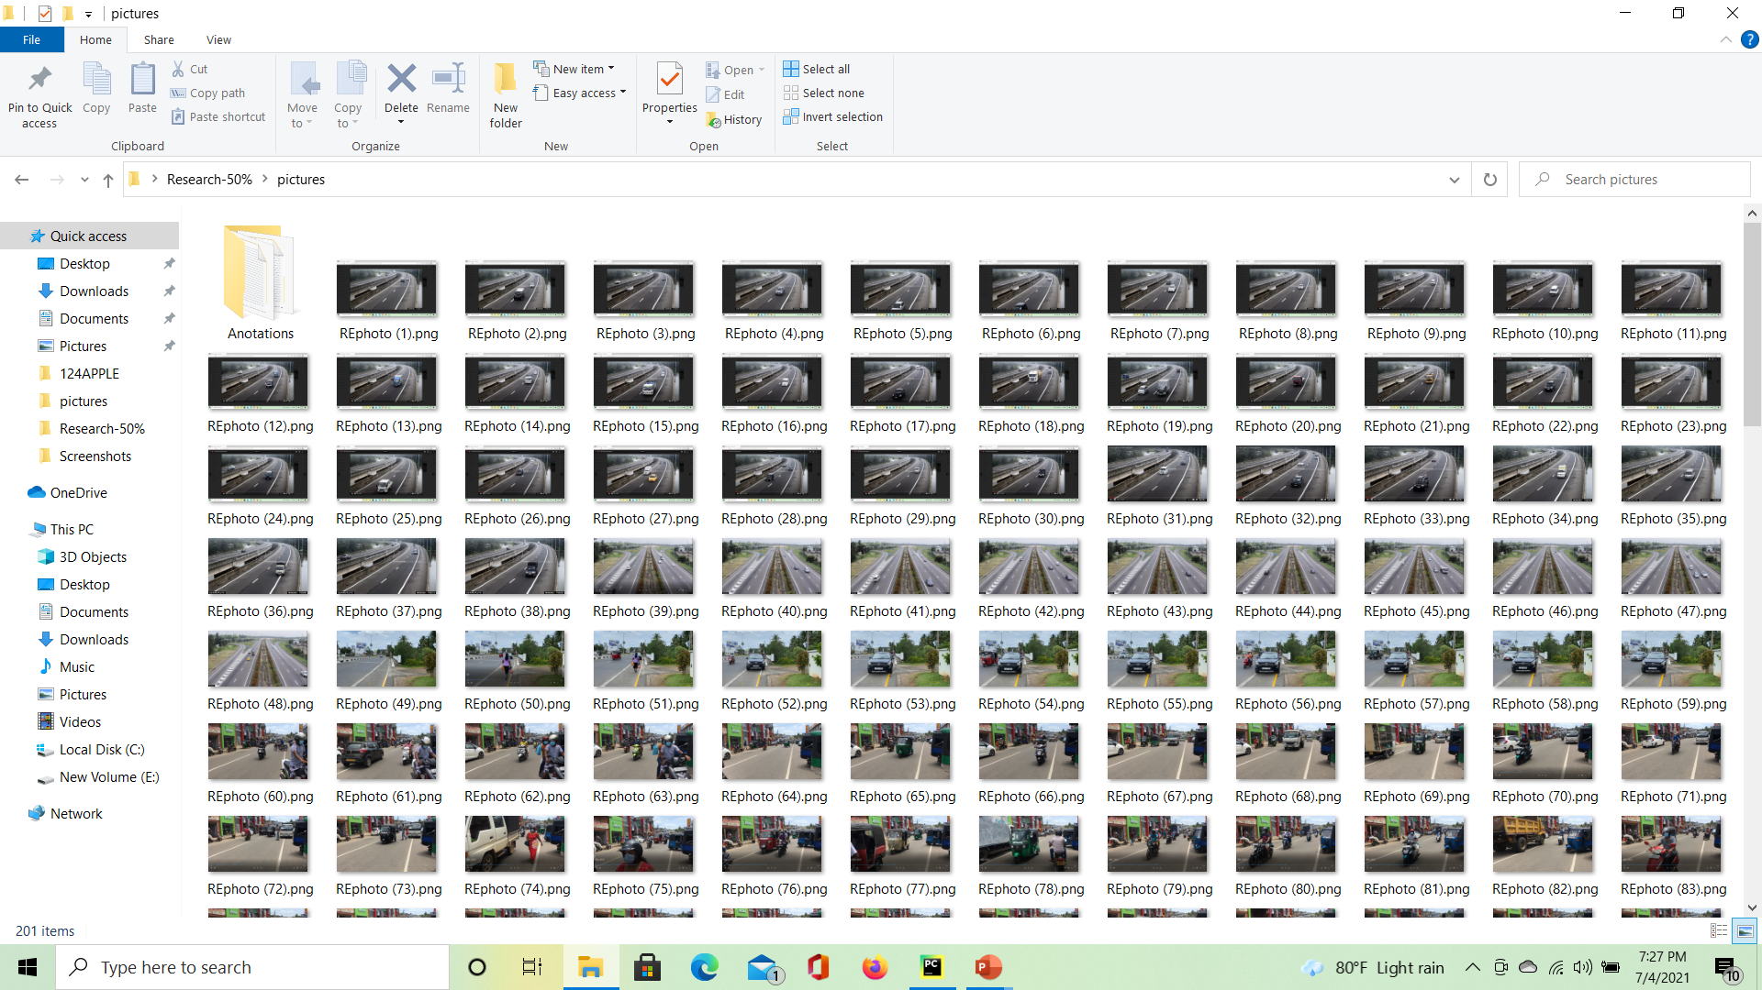
Completion of the project
Collect 12 classes samples (684 images)

Slide 19
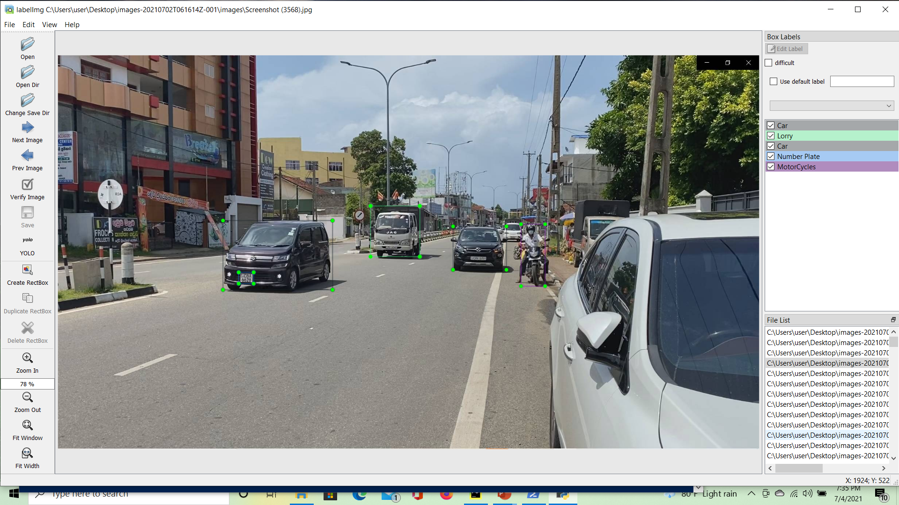
Sample labeling using LabelImg

Slide 20
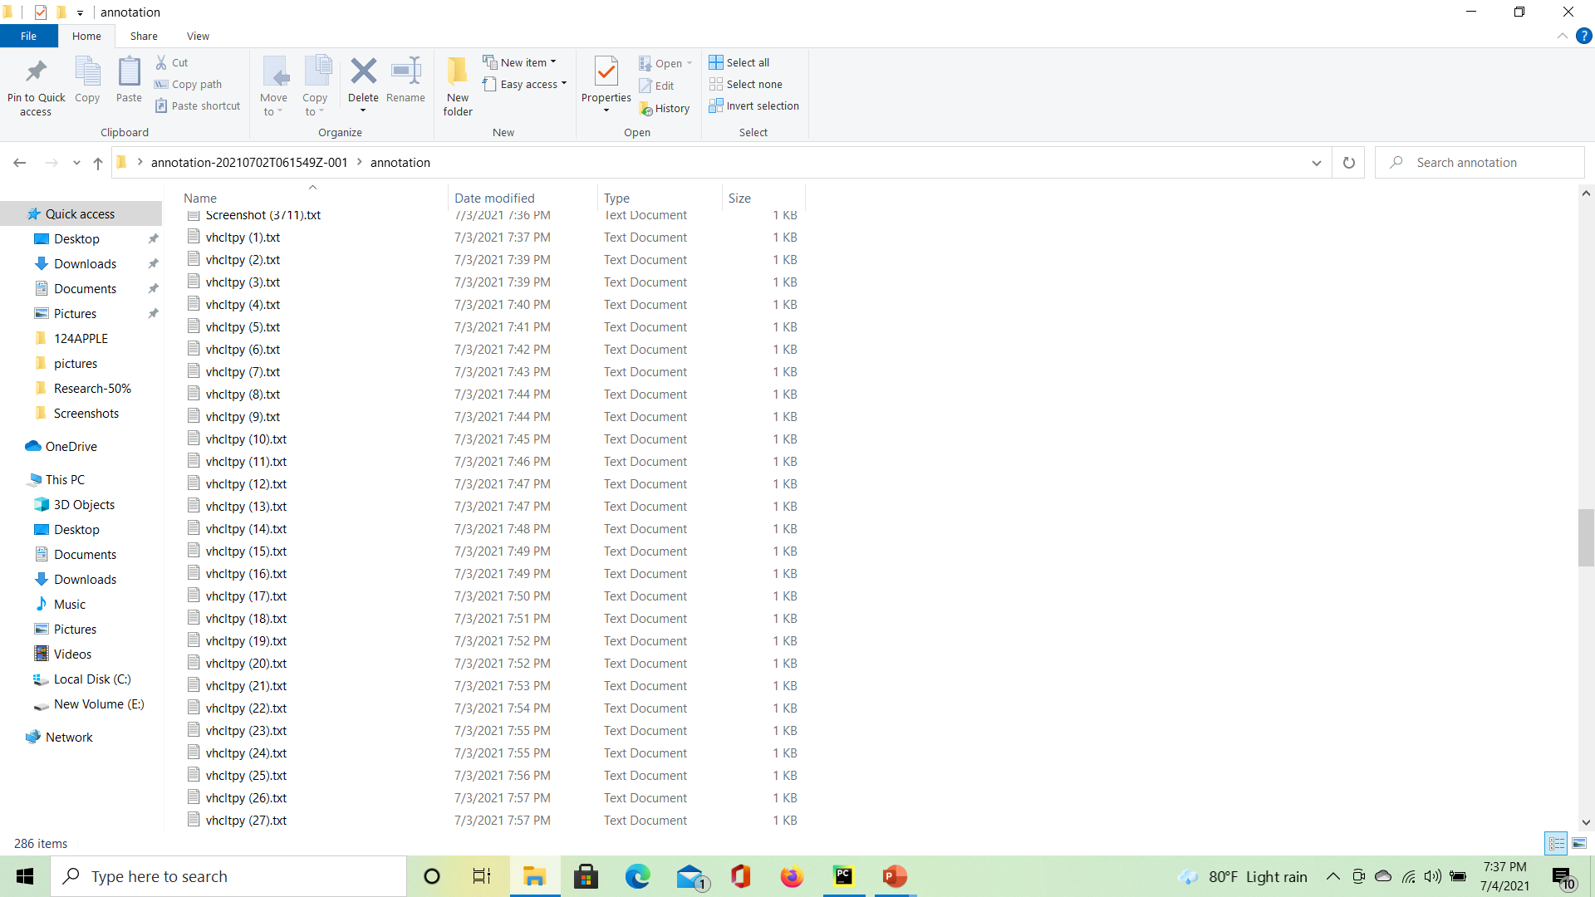
Annotation File

Slide 21
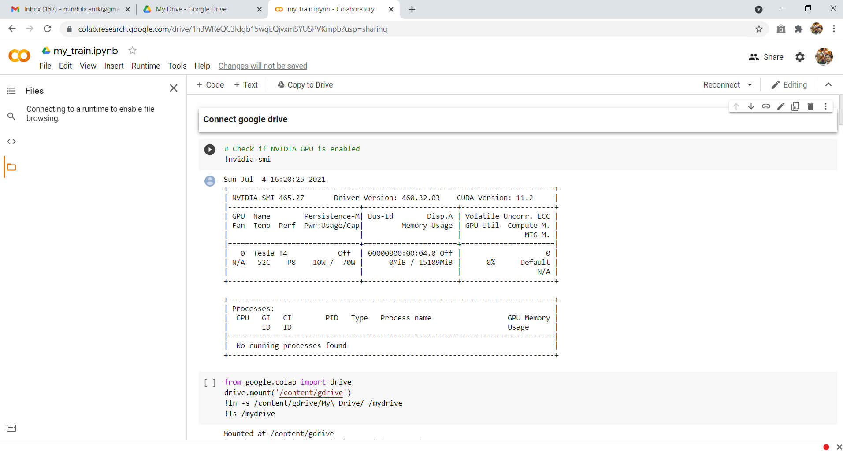
Train the model

Slide 22
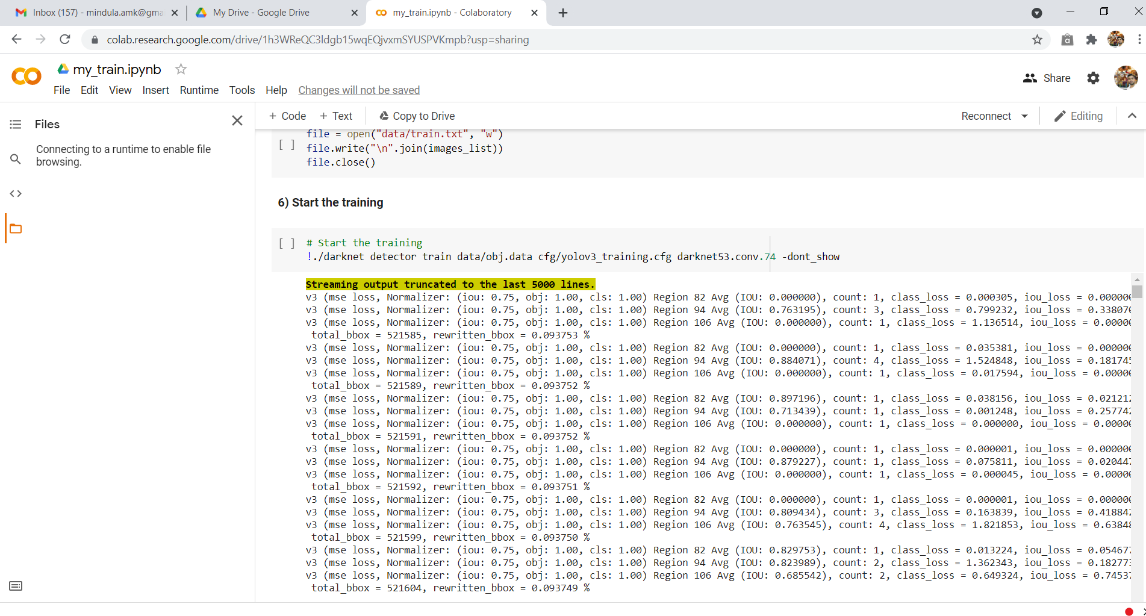
Train the model

Slide 23
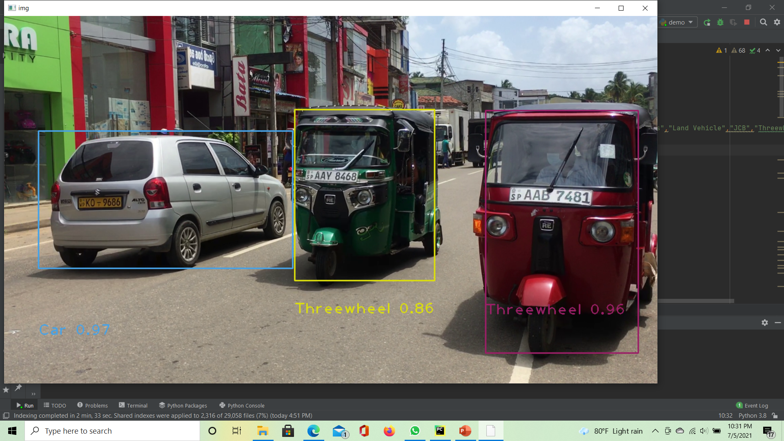
Detecting the Vehicle Type

Slide 24
Commercialization
Our system can be used in expressways.
First give a trial version of the software to the user.
If the user agrees to use the software after using the trial version, then user can purchase the software.
If there are any additional customizations required, then user must pay for those customizations.
IT18134018 | Bojitha Mindula A.M.K | 2021-238

Slide 25
References
[1] G. Sreenu and M. A. Saleem Durai, “Intelligent video surveillance: a review through deep learning techniques for crowd analysis,” Journal of Big Data, vol. 6, no. 1. SpringerOpen, p. 48, Dec. 01, 2019, doi: 10.1186/s40537-019-0212-5.
[2] “(1) (PDF) Review on Image Processing Based Vehicle Detection & Tracking System | International Journal of Scientific Research in Science, Engineering and Technology IJSRSET - Academia.edu.” https://www.academia.edu/37099992/Review_on_Image_Processing_Based_Vehicle_Detection_and_Tracking_System (accessed Feb. 21, 2021).
[3] V. Keerthi Kiran, P. Parida, and S. Dash, “Vehicle detection and classification: A review,” in Advances in Intelligent Systems and Computing, 2021, vol. 1180 AISC, pp. 45–56, doi: 10.1007/978-3-030-49339-4_6.
[4] R. Shreyas, B. V. P. Kumar, H. B. Adithya, B. Padmaja, and M. P. Sunil, “Dynamic traffic rule violation monitoring system using automatic number plate recognition with SMS feedback,” in 2nd International Conference on Telecommunication and Networks, TEL-NET 2017, Apr. 2018, vol. 2018-January, pp. 1–5, doi: 10.1109/TEL-NET.2017.8343528.
IT18134018 | Bojitha Mindula A.M.K | 2021-238

Slide 26

IT18097634 Ranasinghe M.M.C
Software Engineering
IT18097634 | Ranasinghe M.M.C | 2021-238

Slide 27
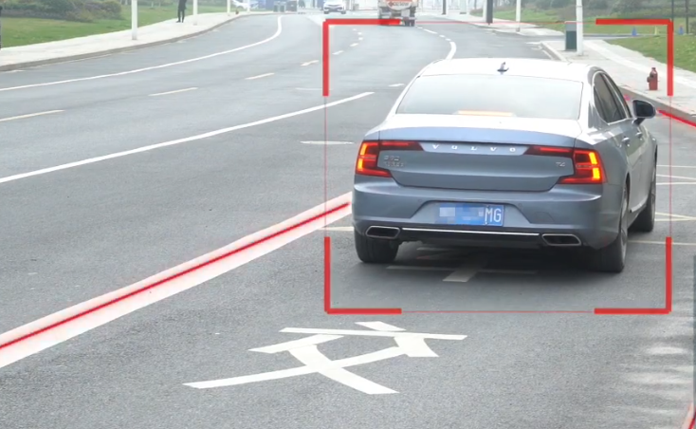
Illegal Vehicle Parking Detection
Automatically identify violations of illegal vehicle parking.
The safety of other vehicles is directly challenged by illegally parked vehicles in the expressway.
IT18097634 | Ranasinghe M.M.C | 2021-238

Slide 28



Background
The ever-increasing number of violations of traffic rules has become a critical challenge in Sri Lanka.
The solution is to install violation detection systems on the expressway.
The system can automatically detect violations of Illegal vehicle parking.
The aim of this research work is to build up an automated system and, also recognize moving vehicle number plate number
IT18097634 | Ranasinghe M.M.C | 2021-238

Slide 29

Research Gap
Comparison of existing solutions
Product | Identify the Rules Violated Vehicle | Identify the Number Plate | Identify Parking Violation | Identify Road Lane Violation | Notify the Management
Illegal Parking [1]
Parking Violation [2]
Detecting Parked [3]
Wrong Way [4]
Lane line detection [5]
Proposed Solution
IT18097634 | Ranasinghe M.M.C | 2021-238

Slide 30

Research Problem
In Sri Lanka expressway there are lot of accidents caused due to the violation of traffic rules by some drivers. But there are no effective methods for detecting those rules violations yet.
We have identified some violations named Parking violation where a vehicle parks in a highway without a permission or a special reason.
Due to above mentioned violations lots of accidents occur in the expressway and those accidents cause lots of severe damages including loss of life.
IT18097634 | Ranasinghe M.M.C | 2021-238

Slide 31
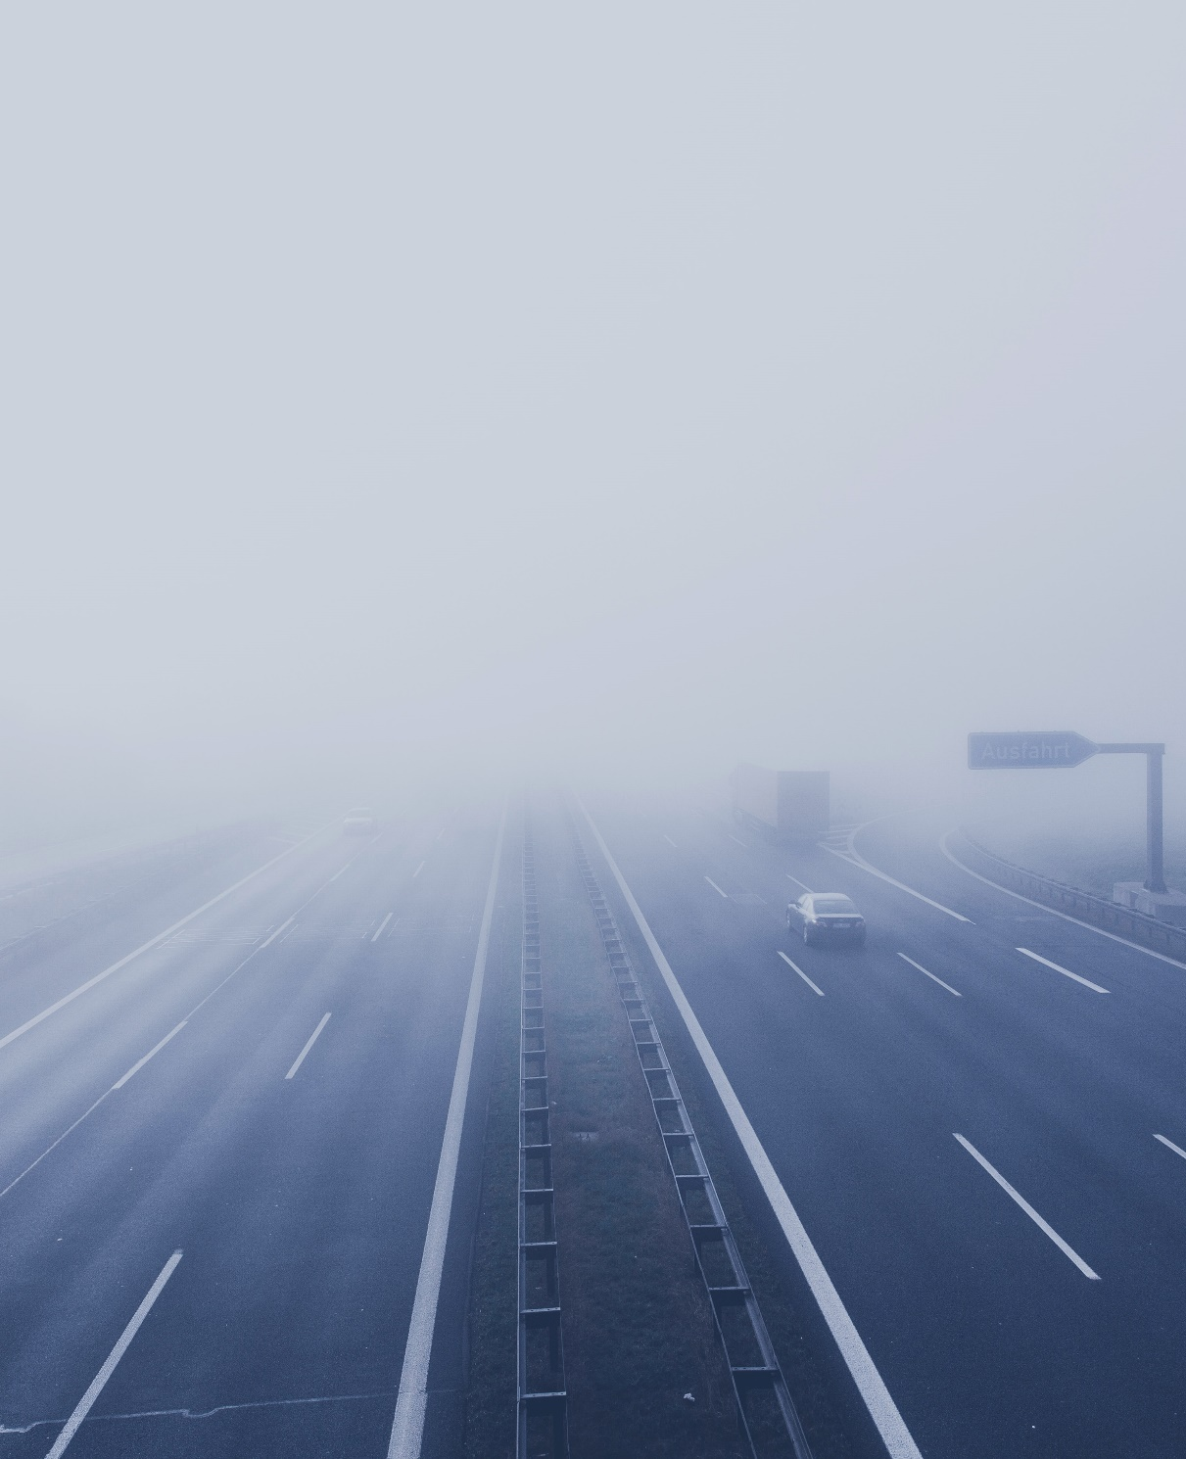
Objective
The major purpose of implementing the automatic vehicle tracking system in the expressway sector is to detect the violation of the traffic rules
Implement function of vehicle detection.
Implement function of detect traffic rules violations.
Implement function of Identify these rules violated vehicle number plate.
Save the details of the database.
IT18097634 | Ranasinghe M.M.C | 2021-238

Slide 32
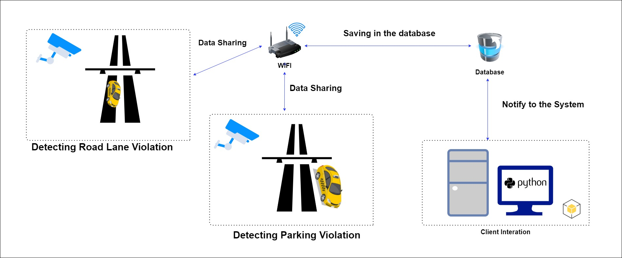
Methodology
System Overview Diagram
IT18097634 | Ranasinghe M.M.C | 2021-238

Slide 33

Technologies and Algorithms
Technologies -
Python
PyCharm
Algorithms -
CNN Algorithm
IT18097634 | Ranasinghe M.M.C | 2021-238

Slide 34
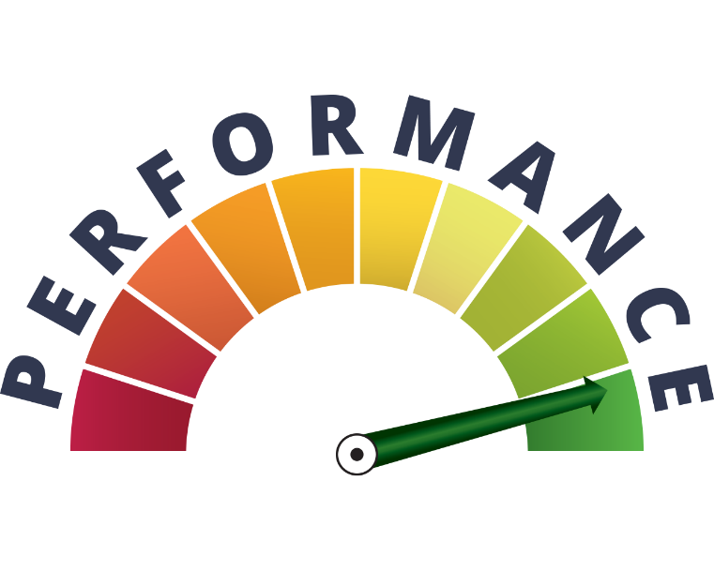


Requirements
Functional Requirements
Detect Illegally parked vehicle.
Identify the number plate of the vehicle
Store the details of the vehicle
Non - Functional Requirements
Performance
Accuracy
User Friendly
IT18097634 | Ranasinghe M.M.C | 2021-238

Slide 35
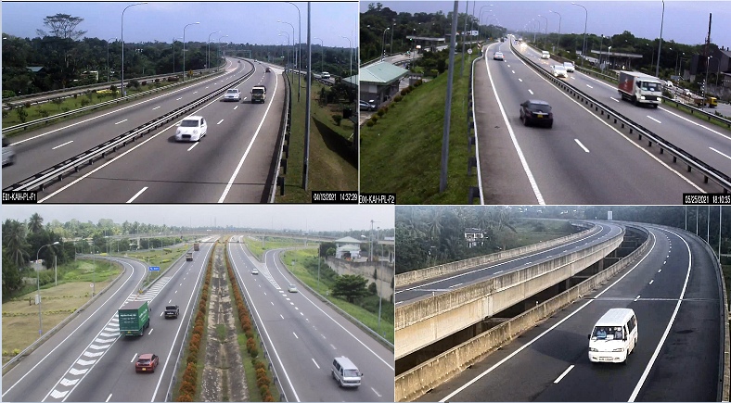
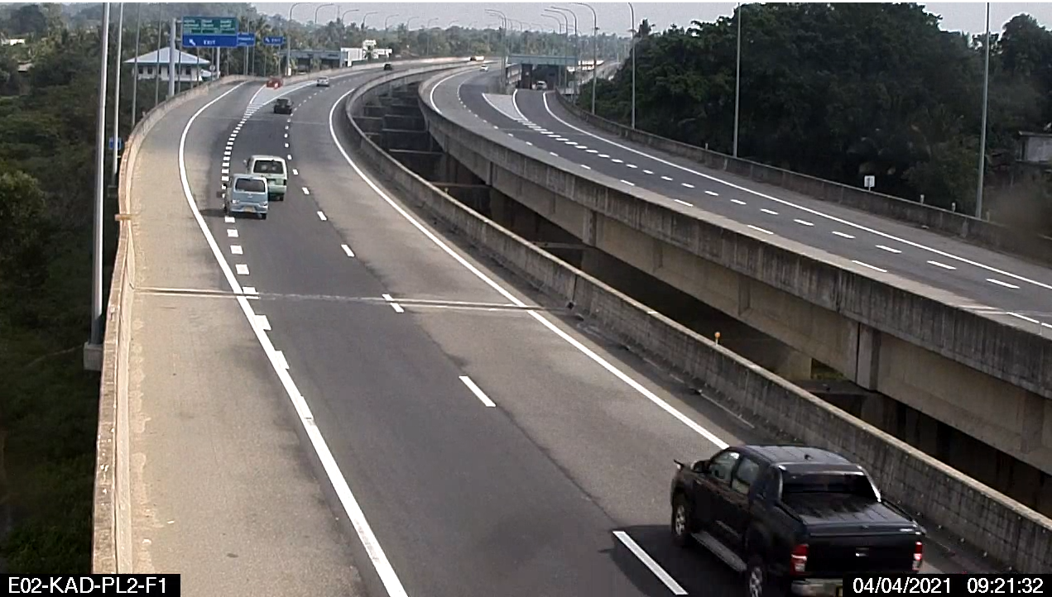
Completion of the project
Dataset
Available 1TB CCTV dataset in expressway
IT18097634 | Ranasinghe M.M.C| 2021-238

Slide 36
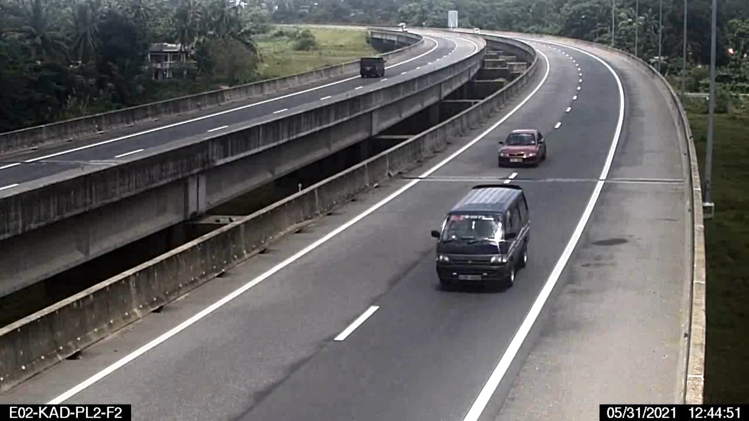
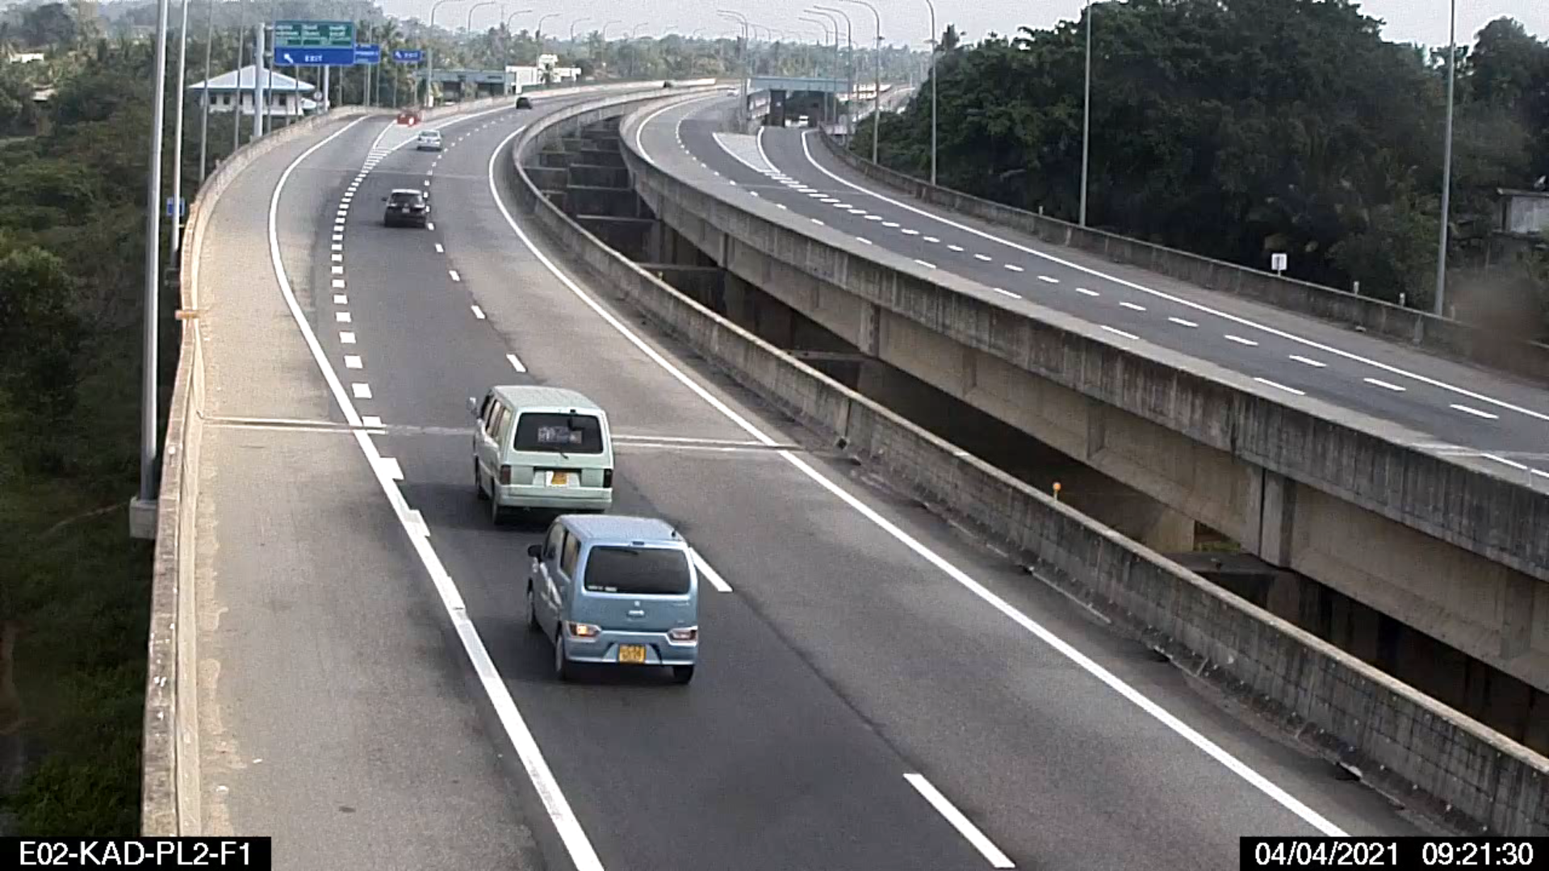
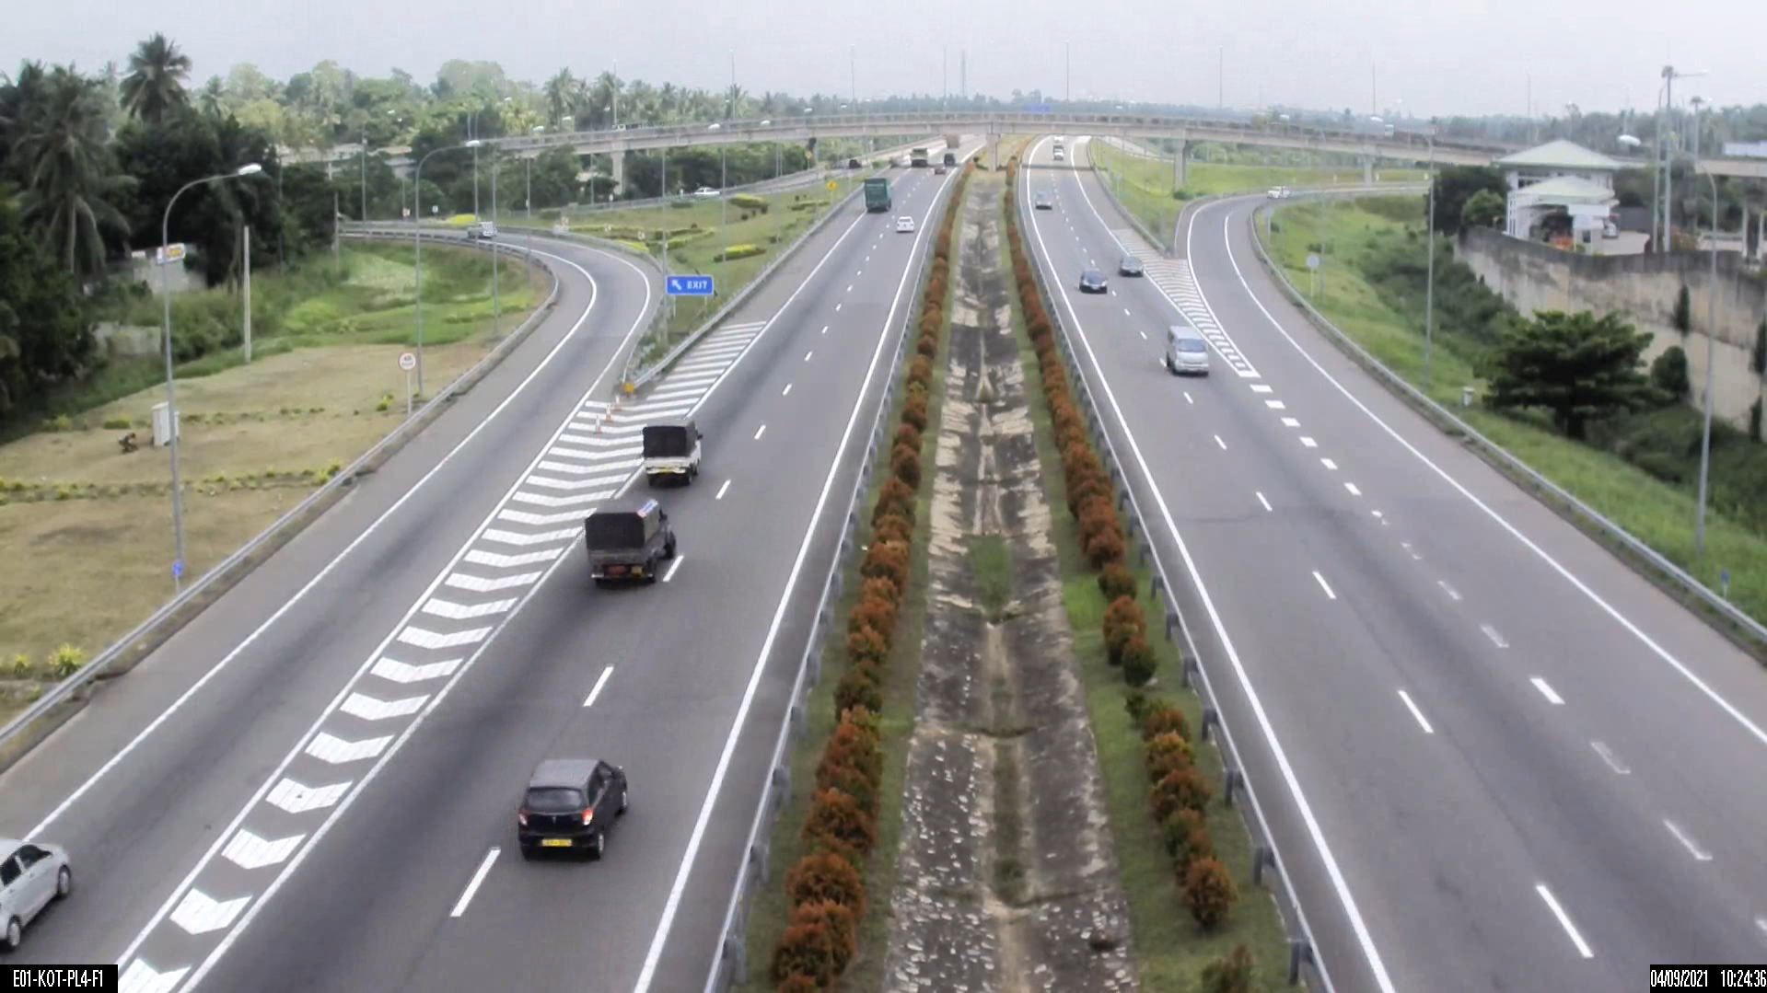
Completion of the project
Dataset
2000 images collected for expressway CCTV Video dataset
IT18097634 | Ranasinghe M.M.C| 2021-238

Slide 37
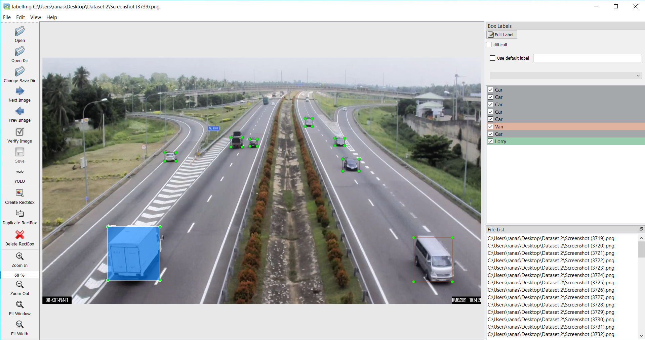
Completion of the project
Label dataset
Add Label images dataset using python labelImg software.
Annotate 2000 images dataset
IT18097634 | Ranasinghe M.M.C| 2021-238

Slide 38
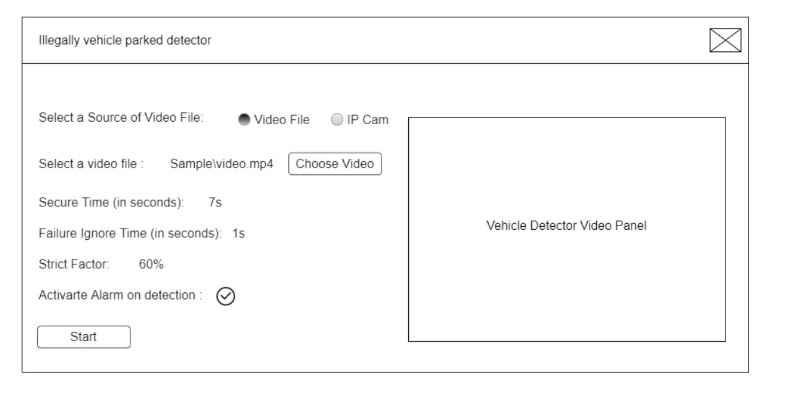
Completion of the project
Frontend development
First design the wireframe
IT18097634 | Ranasinghe M.M.C | 2021-238

Slide 39
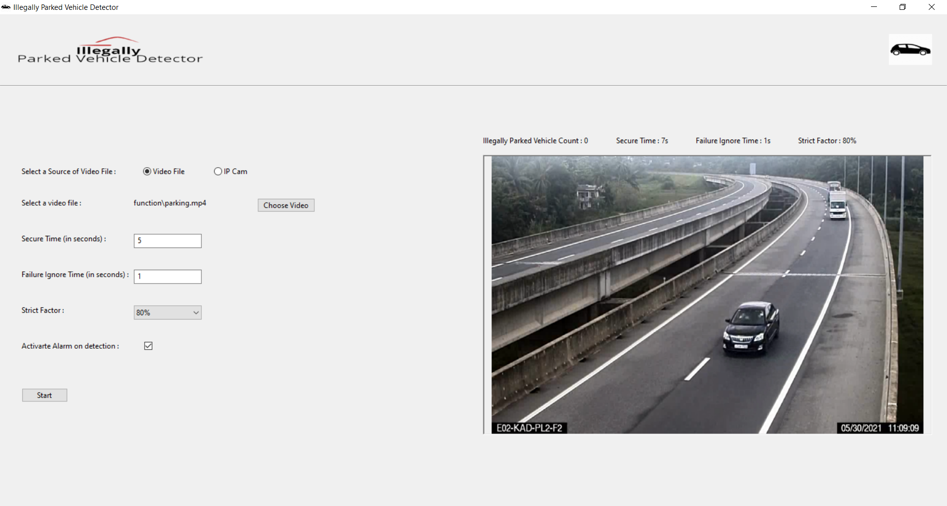
Completion of the project
Frontend development
Wireframe design using wxPython
wxPython is a cross-platform GUI toolkit for the Python programming language.
IT18097634 | Ranasinghe M.M.C | 2021-238

Slide 40
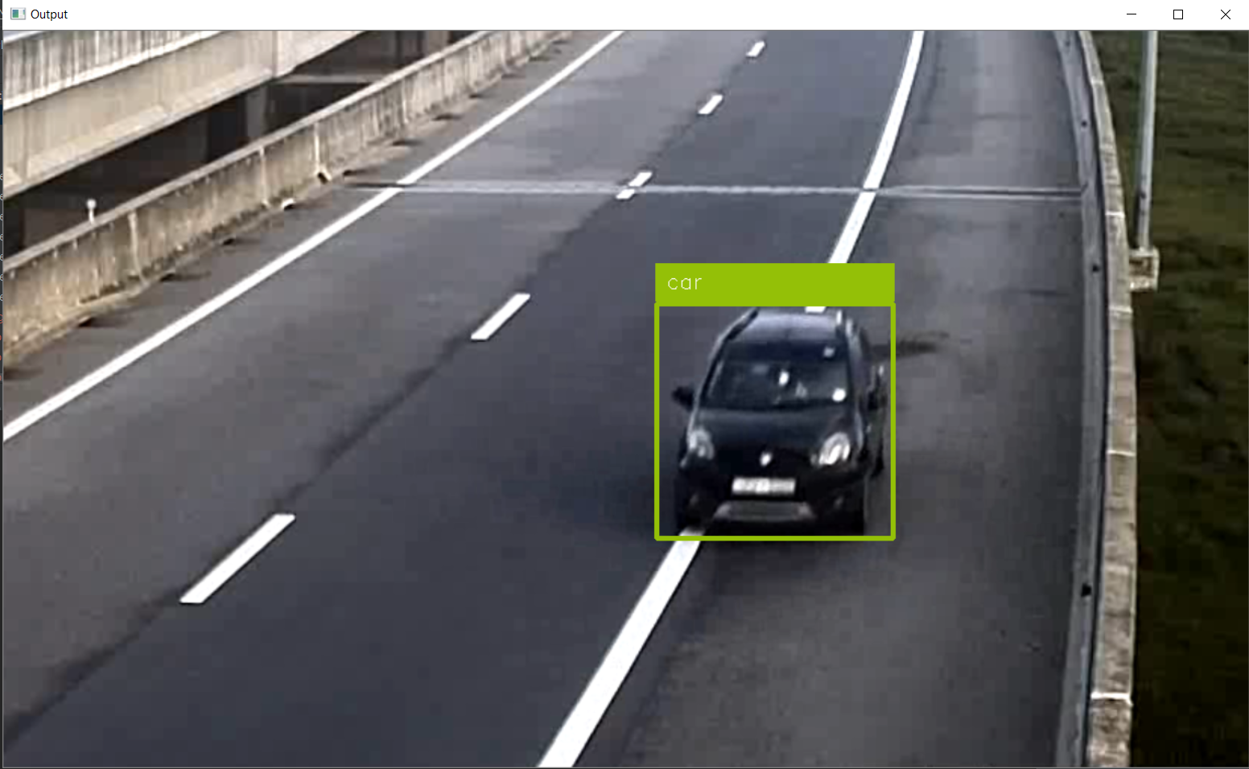
Completion of the project
Vehicle Detection
Vehicle type Identify
Object Detection extracts feature map using a base deep learning network.
Modal train by CNN Algorithm
IT18097634 | Ranasinghe M.M.C| 2021-238

Slide 41
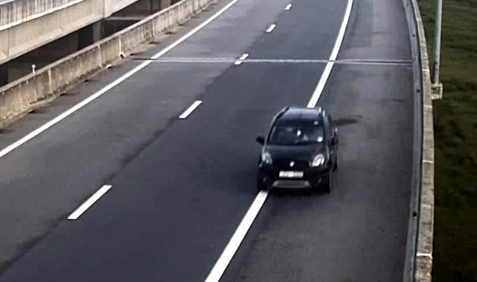
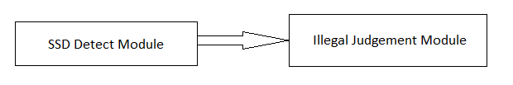
Completion of the project
EXPLANATION
IT18097634 | Ranasinghe M.M.C| 2021-238

Slide 42
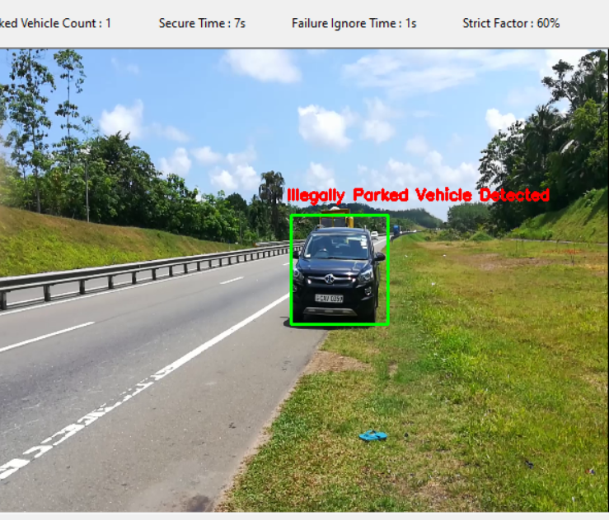
Completion of the project
Illegally parked Vehicle Detection
Our Algorithm maintains five global variables
CURRENT FRAME NO
STRICT_FACTOR
FAILURE_IGNORE_TIME
SECURE TIME
VEHICLE_CONVEHICLE_CON
IT18097634 Ranasinghe M.M.C| 2021-238

Slide 43
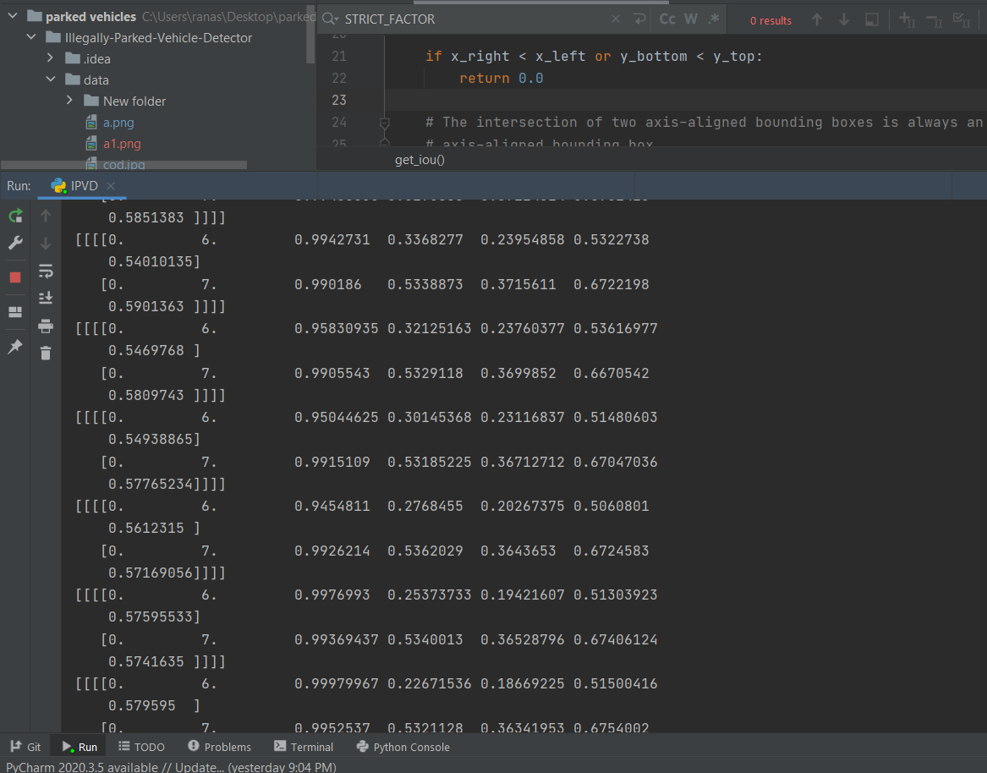
Completion of the project
Accuracy
95% accuracy of illegally vehicle parked detection
IT18097634 Ranasinghe M.M.C| 2021-238

Slide 44

Work Breakdown Structure (WBS)
Violations Detection
1.1 Background Study on Domain
2. Planning
4. Testing
3. Implementation
1. Initiation
1.2 Requirement gathering
1.3 Feasibility Study
2.1 Scope Identification
2.2 Technology selection
2.3 Work breakdown
2.4 Project Proposal Creation
3.1 Implement Vehicle detection
3.2 Implement for Identify vehicle number plate.
3.3 Implement automatically violation detection
3.4 Implement for notify to the management
4.1 Unit Testing
4.2 Integration Testing
4.3 System Testing
5. Finalize
5.1 Research Paper and Final Report
IT18097634 | Ranasinghe M.M.C | 2021-238

Slide 45

Commercialization
Our system can be used in expressways.
First give a trial version of the software to the user.
If the user agrees to use the software after using the trial version, then user can purchase the software.
If there are any additional customizations required, then user must pay for those customizations.
IT18097634 | Ranasinghe M.M.C | 2021-238

Slide 46
References
[1] Rami Alkhawaji, Mohamed Sedky, Abdel-Hamid Soliman, “Illegal Parking Detection Using Gaussian Mixture Model and Kalman Filter“ 2017 IEEE/ACS 14th International Conference on Computer Systems and Applications. Available at: https://ieeexplore.ieee.org/document/8308377
[2] Zhemin Liu, Weiling Chen, Chai Kiat Yeo, “Automatic Detection of Parking Violation and Capture of License Plate” 2019 IEEE 10th Annual Information Technology, Electronics and Mobile Communication Conference (IEMCON). Available at: https://ieeexplore.ieee.org/document/8936164
[3] Wahyono, Alexander Filonenko, and Kang-Hyun Jo, “Detecting Illegally Parked Vehicle Based on Cumulative Dual Foreground Difference” 2016 IEEE 14th International Conference on Industrial Informatics (INDIN). Available at: https://ieeexplore.ieee.org/document/7819263
[4] Ali Şentaş, Seda Kul, Ahmet Sayar, “Real-Time Traffic Rules Infringing Determination Over the Video Stream: Wrong Way and Clearway Violation Detection” 2019 International Artificial Intelligence and Data Processing Symposium (IDAP). Available at: https://ieeexplore.ieee.org/document/8875889
[5] Weiwei Chen, Weixing Wang, Kevin Wang, Zhaoying Li, Huan Li, Sheng Liu, “Lane departure warning systems and lane line detection methods based on image processing and semantic segmentation: A review” Available online 27 November 2020 [sciencedirect] Available at: https://www.sciencedirect.com/science/article/pii/S2095756420301458
IT18097634 | Ranasinghe M.M.C | 2021-238

Slide 47

IT18148732 Tennakoon T.M.P.J.A.
Software Engineering
IT18148732 | Tennakoon T.M.P.J.A. | 2021-238

Slide 48
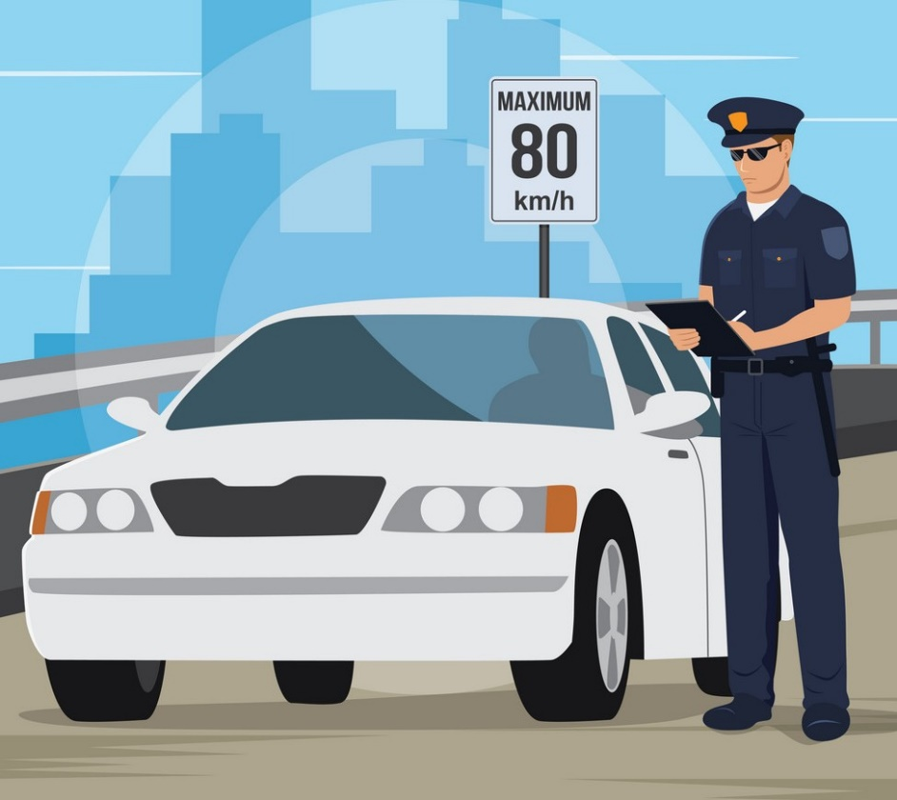
Speed Violation Detection
Speed violation detection means detecting the vehicles that are exceeding the maximum permitted speed limit of the express way.
There are many mechanisms that are using to determine the speeds of the vehicles (RADAR/LIDAR).
But there are several drawbacks in above mechanisms.
Speed violation detection using image and video processing is a good alternative.
IT18148732 | Tennakoon T.M.P.J.A. | 2021-238

Slide 49

Background
Three express ways are being functioned since 2011 and some more will function in near future.
Number of accidents on express ways are drastically increasing.
A major reason is over speed driving.
Police use speed detectors with LIDAR technology to capture over speeding vehicles.
The aim of this research is to build an automated system using image and video processing to detect over speed driving vehicles with their license plate numbers.
IT18148732 | Tennakoon T.M.P.J.A. | 2021-238

Slide 50
Research Gap
Features | Research A | Research B | Research C | Research D | New Product
Good accuracy speed calculation | P | P | P | P | P
Display vehicle speeds in video | X | P | X | X | P
Detecting speed limit exceeding vehicles in video and show them in red colour | X | X | X | X | P
Identify license plate numbers | X | X | X | X | P
Notify the officer with license plate number and speed | X | X | X | X | P
Research A – Speed detection using image processing [1].
Research B – Image processing-based Vehicle Identification and Speed Measurement [2].
Research C – Research of vehicle speed detection algorithm in video surveillance [3].
Research D – An algorithm for automatic vehicle speed detection using video camera [4].
IT18148732 | Tennakoon T.M.P.J.A. | 2021-238

Slide 51

Research Problem
Current used LIDAR systems gives promising results but have drawbacks.
Expensive to acquire and maintain
Detecting the speed of one vehicle at a time
Must be handheld operated
Require periodical maintenance
IT18148732 | Tennakoon T.M.P.J.A. | 2021-238

Slide 52
Objectives
Main Objectives
Detecting the vehicles that are exceeding the speed limits
Inform the officer with license plate numbers and speeds
Sub Objectives
Calculating the speeds of vehicles in the video with a good accuracy and embedding the speed beside the relevant vehicle in the video.
Detect the vehicles that are over speeding and showing those vehicles in red colour.
Identify license plate numbers of over speed driving vehicles
Over speed driving vehicles will notified to the officer with license plate numbers and speeds
Save the output video with speeds for future use.
IT18148732 | Tennakoon T.M.P.J.A. | 2021-238

Slide 53
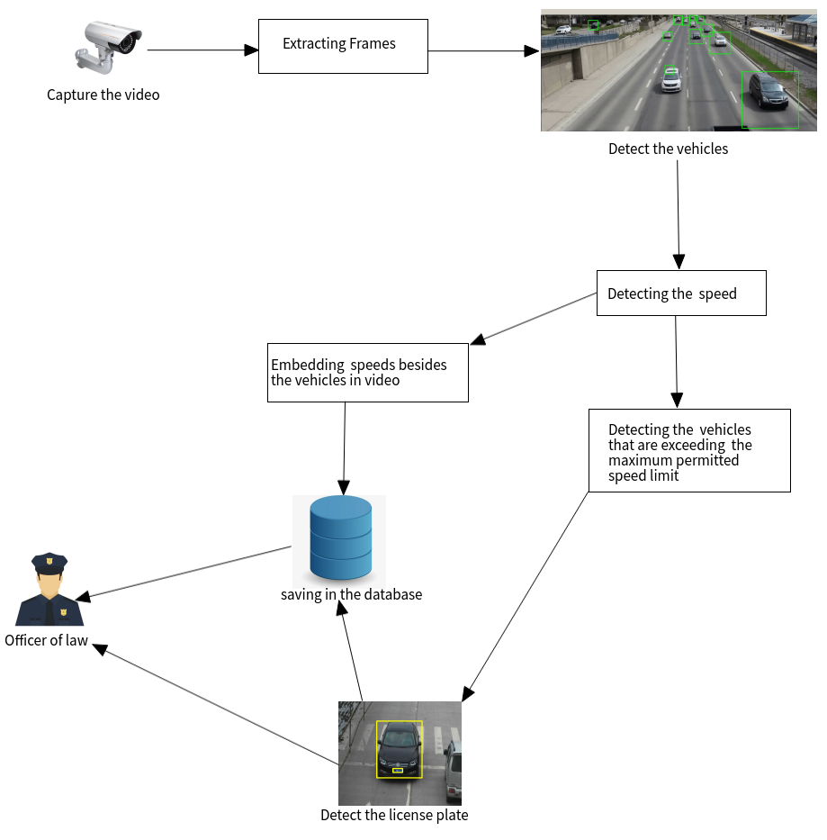
Methodology
System Overview Diagram
IT18148732 | Tennakoon T.M.P.J.A. | 2021-238

Slide 54
Methodology
Input videos obtained through CCTV cameras placed in the highways.
Then the individual frames are extracted from the video.
Then the frames are preprocessed and resized using OpenCV functions.
After, frames are converted to its grayscale equivalent using OpenCV functions.
Haar Classifier with Adaboost technique is used for vehicle detection.
The correlation tracker function of the dlib library is used to track the vehicles in the video.
From above phases position of the vehicle is obtained in terms of pixel units.
In calculating speed, initially the change in pixels is calculated using coordinates obtained.
Then the distance in terms of pixel units is converted into the SI units of distance.
The time elapsed is obtained by camera’s frame rate settings (fps value).
Then the speed is calculated by multiplying distance by fps value and then by 3.6 which is used to convert the speed into kilometers per hours.
IT18148732 | Tennakoon T.M.P.J.A. | 2021-238

Slide 55
Algorithms and Technologies
Algorithms
Haar Classifier
Adaboost
Technologies
Python
Pycharm
IT18148732 | Tennakoon T.M.P.J.A. | 2021-238

Slide 56
Requirements
Functional Requirements
Detecting the speeds of vehicles in the video
Detecting the vehicles that are exceeding the maximum permitted speed limit show them in red colour
Embedding the speeds of vehicles beside the vehicles in the video
Recognize the license plate of vehicles that are exceeding the speed limit
Informing the officer of law about the vehicles that are violating the speed rule with their license plate numbers and the speeds of those vehicles
Saving the output video for the future use
Saving the details of overspeed driving vehicles
Non-Functional Requirements
Performance
Accuracy
User Friendly
IT18148732 | Tennakoon T.M.P.J.A. | 2021-238

Slide 57
Requirements cont’d
System Requirements
OS: Windows 10,8,7
CPU: Intel or AMD processor with 64-bit support
GPU: NVidia GeForce GTX 1050 or equivalent
Disk Storage: 5 GB of free disk space
Internet: Highspeed stable internet connection
Personnel Requirements
User has little bit knowledge of use software application
Remove unnecessary data
IT18148732 | Tennakoon T.M.P.J.A. | 2021-238

Slide 58
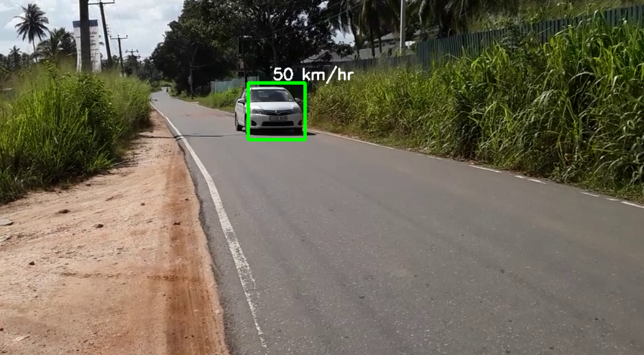
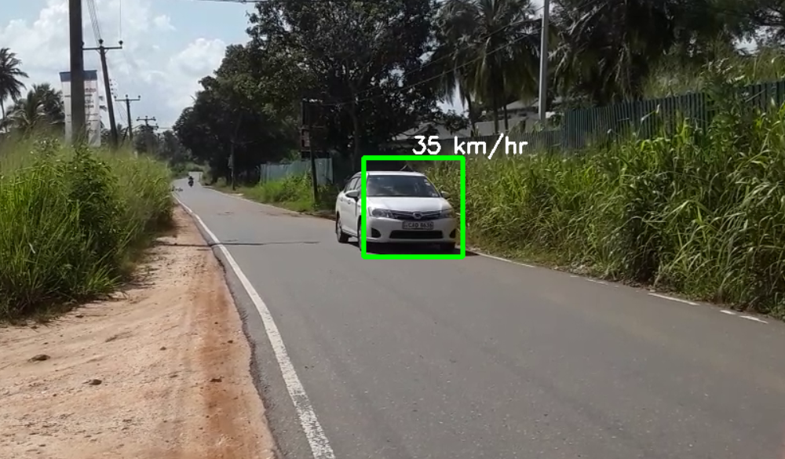
Evidences for the completion
Above 90% accuracy in speed calculation
The speed estimation of the vehicle that actually traveled in 50km/hr
The speed estimation of the vehicle that actually traveled in 30km/hr
IT18148732 | Tennakoon T.M.P.J.A. | 2021-238

Slide 59
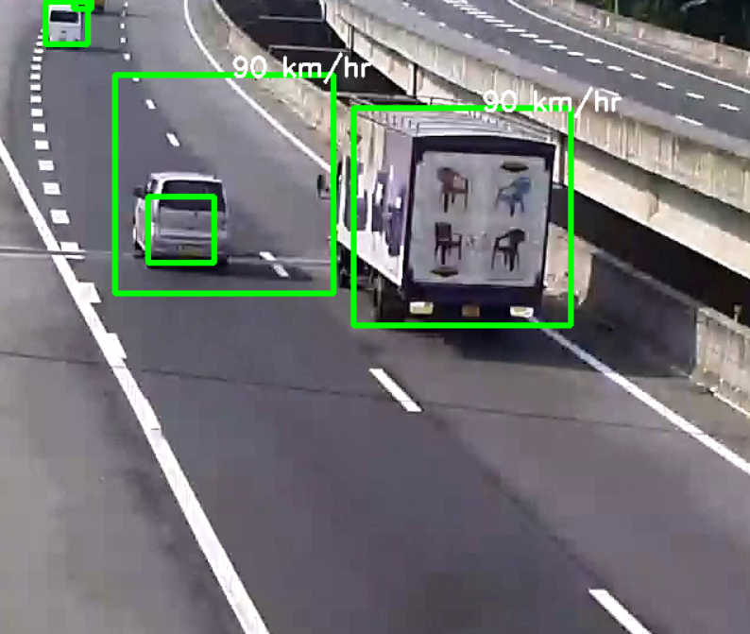
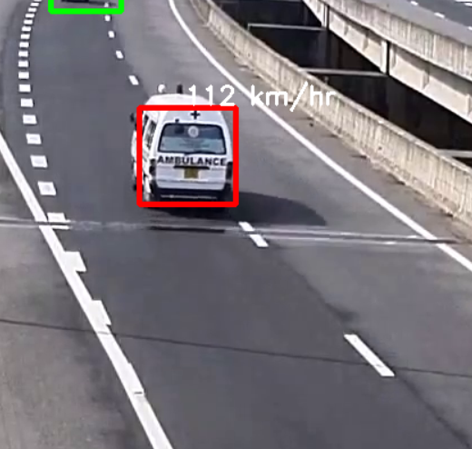
Evidences for the completion
The vehicles that have under 100km/h speed (which are not violating the speed rule) are showing in green color with relevant speed and vehicles that have speed beyond 100km/h (which are violating speed rule) are showing in red color with the relevant speed
Vehicles that are not violating the speed rule
Vehicle violating the speed rule is detected in red.
IT18148732 | Tennakoon T.M.P.J.A. | 2021-238

Slide 60
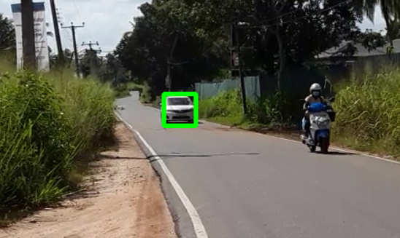
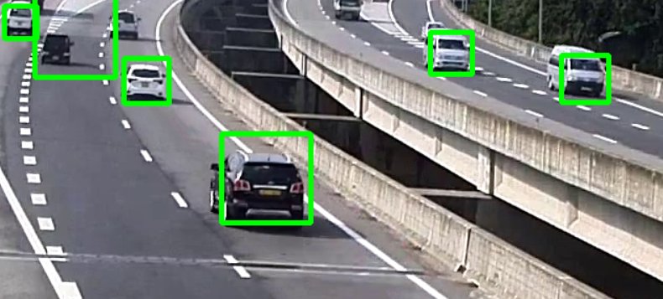
Evidences for the completion
Vehicles that need to detect the speed are clearly detect out of the background seen.
In this picture the motorcycle is not detected because we don’t need to detect the speed of motorcycle (motorcycles are not allowed in highways).
IT18148732 | Tennakoon T.M.P.J.A. | 2021-238

Slide 61
Work Breakdown
Speed Violation Detecting System
1.1 Research on the domain
2. Planning
4. Testing
3. Implementation
1. Initiation
1.2 Requirement gathering
1.3 Feasibility Study
2.1 Scope selection
2.2 Technology selection
2.3 Work breakdown
2.4 Project proposal development
3.1 Data collection (CCTV Videos) and Extracting Frames
3.2 Detecting the vehicles
3.3 Calculating speeds and detecting over speed driving vehicles
3.4 Recognize license plate numbers of over speed driving vehicles
4.1 Unit testing
4.2 Integration testing
4.3 System testing
3.6 Inform to the officer
5. Finalize
5.1 Final report and research paper
3.5 Embedding the speeds beside the vehicles in the video
IT18148732 | Tennakoon T.M.P.J.A. | 2021-238

Slide 62
Commercialization
Our system can be used in expressways
First give a trial version of the software to the user
If the user agrees to use the software after using the trial version, then user can purchase the software
If there are any additional customizations required, then user must pay for those customizations
IT18148732 | Tennakoon T.M.P.J.A. | 2021-238

Slide 63
References
[1] P. K. Thadagoppula and V. Upadhyaya, "Speed detection using image processing," 2016 International Conference on Computer, Control, Informatics and its Applications (IC3INA), Tangerang, 2016, pp. 11-16, doi: 10.1109/IC3INA.2016.7863015.
[2] S. Kamoji, D. Koshti, A. Dmonte, S. J. George and C. Sohan Pereira, "Image Processing based Vehicle Identification and Speed Measurement," 2020 International Conference on Inventive Computation Technologies (ICICT), Coimbatore, India, 2020, pp. 523-527, doi: 10.1109/ICICT48043.2020.9112419.
[3] J. Wang, "Research of vehicle speed detection algorithm in video surveillance," 2016 International Conference on Audio, Language and Image Processing (ICALIP), Shanghai, 2016, pp. 349-352, doi: 10.1109/ICALIP.2016.7846573.
[4] Jianping Wu, Zhaobin Liu, Jinxiang Li, Caidong Gu, Maoxin Si and Fangyong Tan, "An algorithm for automatic vehicle speed detection using video camera," 2009 4th International Conference on Computer Science & Education, Nanning, China, 2009, pp. 193-196, doi: 10.1109/ICCSE.2009.5228496.
[5] “(PDF) Real-time automatic license plate recognition for CCTV ...”. [Online]. Available: https://www.researchgate.net/publication/257694469_Realtime_automatic_license_plate_recognition_for_CCTV_forensic_applications. [Accessed: 25-Feb.-2021].
IT18148732 | Tennakoon T.M.P.J.A. | 2021-238

Slide 64

IT18185812 Rushdy Ahamed M.H
Information Technology
IT18185812 | Rushdy Ahamed M.H | 2021-238

Slide 65
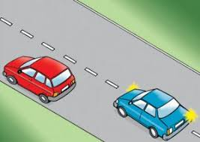
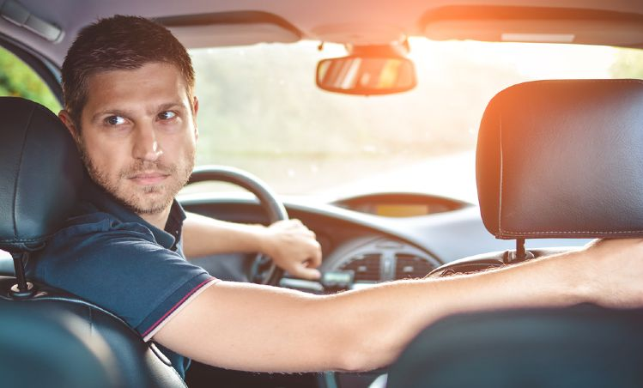
Vehicle Signal and Reverse Violations Detection
There are no proper systems to detect traffic rules violations on expressway.
Tracking mechanism for detect signal light violation and a reverse violation
Automatic identification of traffic rules violated vehicles for use video surveillance
IT18185812 | Rushdy Ahamed M.H | 2021-238

Slide 66
Background
The ever-increasing number of violations of traffic rules has become a critical challenge in Sri Lanka.
The solution is to install violation detection systems on the expressway.
The system can automatically detect violations of vehicle signal light while overtaking and driving on the wrong direction.
The aim of this research work is to build up an automated system.
IT18185812 | Rushdy Ahamed M.H | 2021-238

Slide 67
Research Gap
Comparison of former research
Research | Object identifier | Vehicle signal light violation detection | Reverse violation detection | License plate detection | Notification receiver
A
B
C
D
E
Proposed System
A – Automatic detection of car turn signals [2]
B – Real-time vehicular traffic violation detection [3]
C – Driver direction control model [4]
D – Deep learning-based detection of one-way traffic rule violation [1]
E – Turn signal recognition in the frequency domain [6]
IT18185812 | Rushdy Ahamed M.H | 2021-238

Slide 68
Research Problem
Considering Sri Lanka’s Express way there are lots of accidents occur due to the violations of traffic rules. But still they did not come across the proper solution.
Vehicle can overtake another vehicle without using a signal light and vehicle can drive reverse direction, if they miss the exit ramp or entered through a wrong ramp.
Due to above mentioned violations lots of accidents occur in the expressway and those accidents cause lots of severe damages including loss of life.
IT18185812 | Rushdy Ahamed M.H | 2021-238

Slide 69

Objective
Develop a system to reduce the occurrence of accidents by implementing tracking mechanism to detect violations on Express way.
Cover the entire road using CCTV
If the vehicle is moving on reverse direction, the system display it as a “Reverse violation”
In the overtake violation, when vehicle is overtaking another vehicle without using a proper signal light, the system detects as a “Overtake violation”
System displays the vehicle information such as, Vehicle type, violation type, license plate and date and time
IT18185812 | Rushdy Ahamed M.H | 2021-238

Slide 70
Methodology
CCTV cameras captures the real time moving vehicles from the Express way.
The frames are divided into single size from captured Data.
The frames are preprocessed and resized using OpenCV functions.
Then the next step is to load the video and convert it into gray-scale.
TensorFlow is used to detects, locating and tracing a vehicle from a video.
YOLO algorithm is used to get high accuracy and speed of object detection in real-time.
In the reverse violation, first system check if vehicle is driving on wrong direction, then system detect that object.
Then individual frames are point into the specific object and display this is a reverse violation.
In the overtake violation, when one object is overtaking another object, It will be detected first using YOLO.
After that set the annotations to the overtaking vehicle object and check whether lights are on/off. If light is off within specific time duration, It will be detecting and give output as an overtaking violation, Otherwise usually system run its own way.
IT18185812 | Rushdy Ahamed M.H | 2021-238

Slide 71
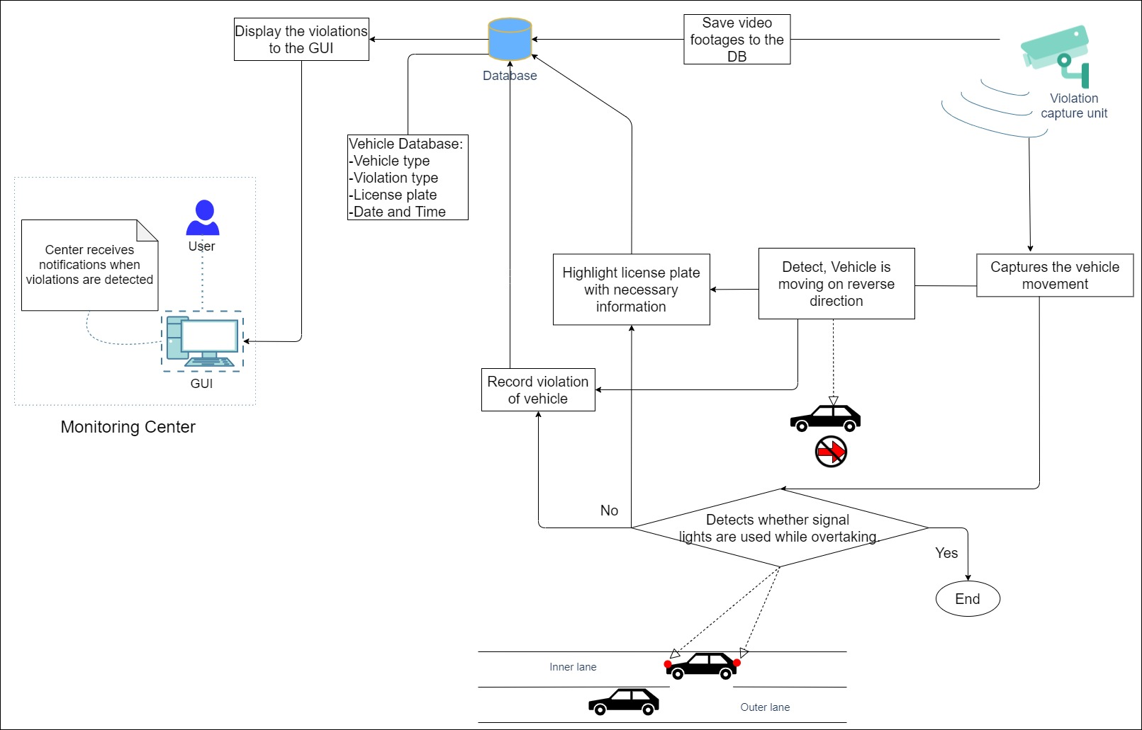
Methodology
Component Overview Diagram
IT18185812 | Rushdy Ahamed M.H | 2021-238

Slide 72
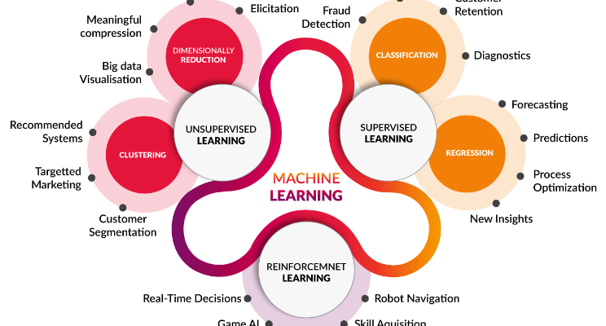
Technologies and Algorithms
Python – OpenCV, TensorFlow, YOLO
Haar Classifier
Pycharm Tool
Image Classification
Image Segmentation
Convolutional neural networks
Faster R-CNN Deep Learning
Computer vision
background subtraction
IT18185812 | Rushdy Ahamed M.H | 2021-238

Slide 73
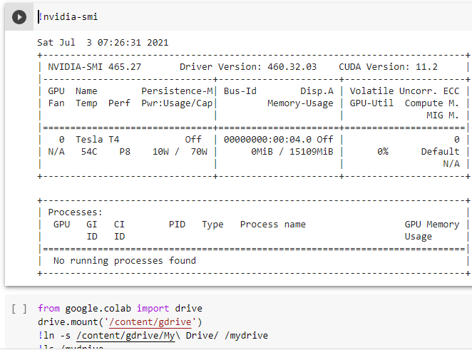
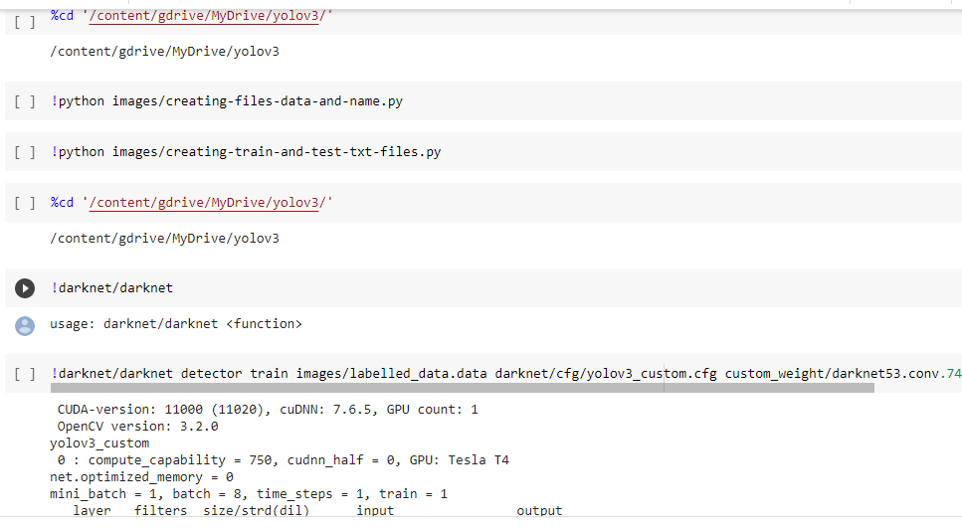
Evidences for the Completion
Data trained using colab
IT18185812 | Rushdy Ahamed M.H | 2021-238

Slide 74
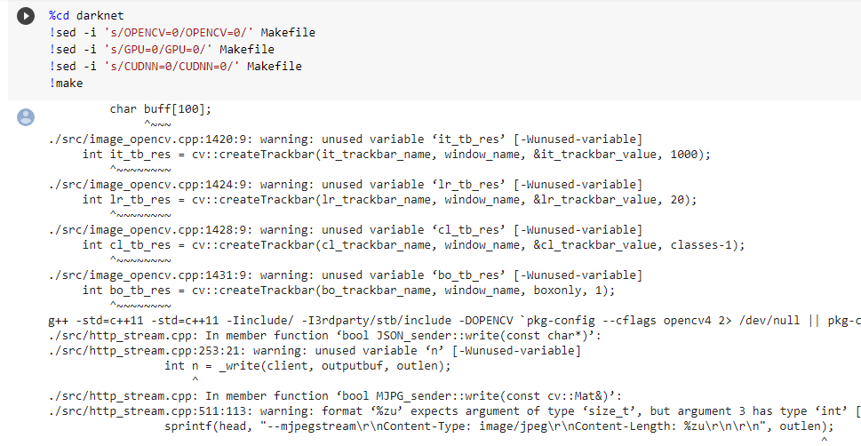
Evidences for the Completion
IT18185812 | Rushdy Ahamed M.H | 2021-238

Slide 75
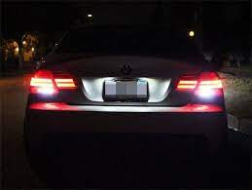
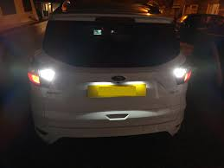
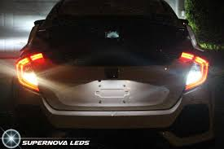
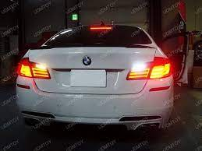
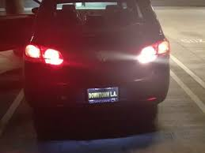
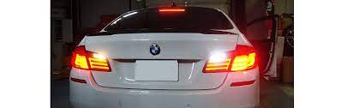
Evidences for the Completion
Used annotations for reverse violation
IT18185812 | Rushdy Ahamed M.H | 2021-238

Slide 76
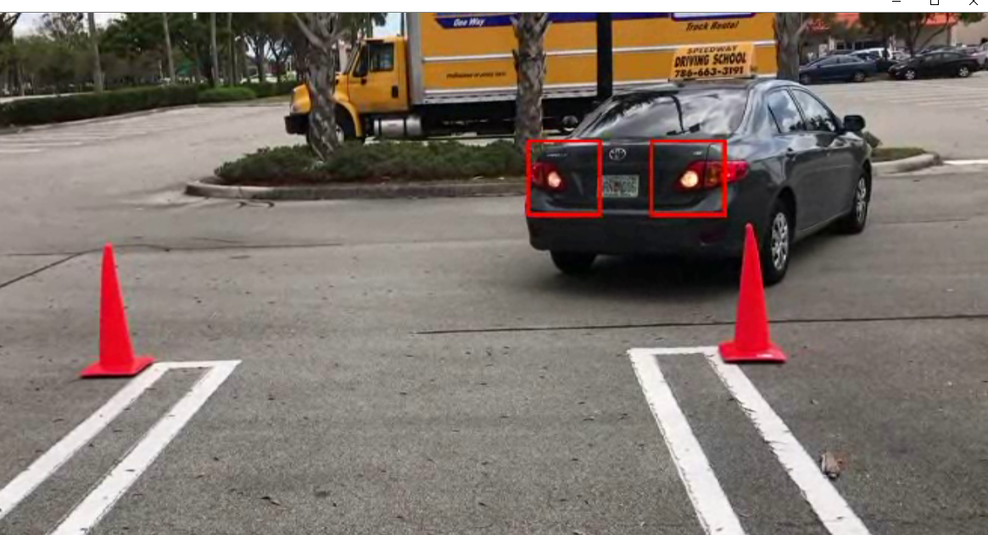
Evidences for the Completion
Reverse violation detection using YOLO motion detection algorithm
The headlight must be turn on when vehicle is reversing
Set annotation to the headlight and can detect if vehicle is moving on reverse direction
IT18185812 | Rushdy Ahamed M.H | 2021-238

Slide 77
Requirements
Functional Requirements
The system should be able to detects signal violation
The system should be able to detects vehicle is moving on reverse direction as violation
The system should be able to track the license plate of those violating vehicles with necessary information
Output as receive violation notification of the vehicles
Non - Functional Requirements
Availability
Accuracy
Performance
Scalability
Flexibility
IT18185812 | Rushdy Ahamed M.H | 2021-238

Slide 78
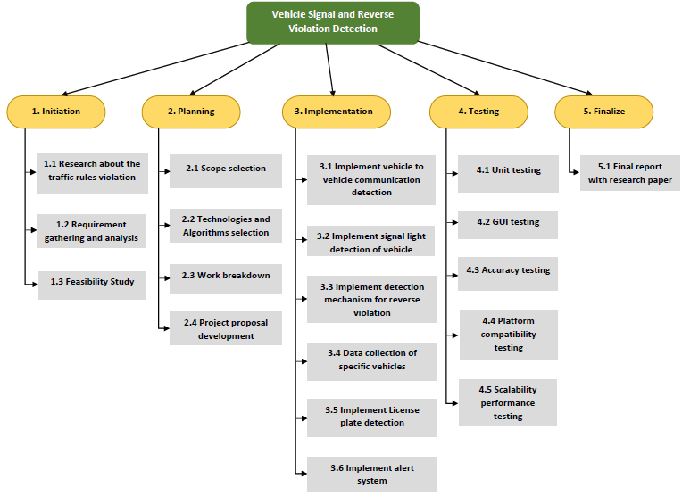
Work Breakdown Structure (WBS)
IT18185812 | Rushdy Ahamed M.H | 2021-238

Slide 79

Commercialization
Since Sri Lanka does not have any kind of market, our system can be used in Express way.
Free at The Initial Stage and give a trial version.
If user prefer to use, they can purchase the system
IT18185812 | Rushdy Ahamed M.H | 2021-238

Slide 80
References
[1] A. Samir, "Automatic Traffic Violation Recording and Reporting System to Limit Traffic Accidents," International Journal of Wireless & Mobile Networks, vol. 10, no. 1, p. 6, 2019.
[2] B. Julian, K. Adam, M. Tomasz, D.Adam, M. Krzysztof, P. Karol, Julian B, "Automatic detection of traffic lights changes from red to green and car turn signals in order to improve urban traffic," IEEE, Egypt, 2014, pp. 1-6.
[3] O. Guoyu, G. Yang, L. Ying, “Real-Time Vehicular Traffic Violation Detection in Traffic monitoring Stream,” In Proc. IEEE/WIC/ACM International Conferences on Web Intelligence and Intelligent Agent Technology 2012, pp. 1-5.
[4] I. Samir, I. Ragim, K. Boris, K. Vladimir, "Algorithm for detecting violations of traffic rules based on computer vision approaches," MATEC Web of Conferences, vol. 5, no. 55, pp. 1-4, 2017.
[5] J.N Lodwick, "Expressway Operation Maintenance and Management Division Road Development Authority - Sri Lanka," Expressway, 2017. [Online]. Available: http://www.exway.rda.gov.lk/index.php?page=contact_us. [Accessed 22 February 2021].
[6] F. Bjorn, E. Markus, F. Uwe, "Car Change the Lane? - Turn Signal Recognition in the frequency domain," IEEE Intelligent Vehicles Symposium, vol. 4, pp. 8-11, 2014.
IT18185812 | Rushdy Ahamed M.H | 2021-238

Slide 81


Slide 82

Questions ?

